Slide 1
LIVER PATIENT DATA ANALYSIS

Slide 2
GROUP NAME ➔Machine Learning Bloodgroup
MEMBERS ➔ 1.Sourav Manjhi
2.Surbhi Sethi
3.K.V.Madhuvani

Slide 3
INTRODUCTION
All sectors of society today generate data hence we need a strategy to analyze and put use of this data. Machine learning is such a strategy which is also a subfield of artificial intelligence (AI).
The goal of machine learning generally is to understand the structure of data and fit that data into models that can be understood and utilized by people to predict the outcome.
We use python as a tool to implement machine learning for the analysis of the data.

Slide 4
Python is simple and easy to learn , which is a big part of its appeal in machine learning .
Python helps with a complex set of machine learning tasks which makes Python a frequently sought-after language skill in the tech world.
This analysis examines data from liver patients concentrating on relationships between a key list of liver enzymes, proteins and age using them to predict the likeliness of liver disease.

Slide 5
OBJECTIVES OF PROJECT
The objective of this project is as following:
➔to analyse data of health care industry regarding liver health conditions
➔to give predict the status of a patient’s liver condition
➔to classify the condition as healthy or diseased
➔to find out the main causes of disease
➔to use findings so that suggestions could be given on basis of data inference

Slide 6
PROBLEM STATEMENT
The Indian Liver Patient dataset was collected from the northeast area of the Andhra Pradesh state in India. This is a binary classification problem with the class labeled as liver patient (represented as 1 in the dataset) and patients without any liver disease(represented as 2)
There are 583 observations, 416 represent subjects with diseased livers, 167 represent subjects without diseased livers.
The data represent 441 male subjects (of whom 324 have liver disease) and 142 female subjects (of whom 92 have liver disease).
The goal of this analysis is to see how well a logistic regression , support vector and random forest algorithm approaches can be tuned on this data to predict the presence of liver disease

Slide 7
REVIEW OF LITERATURE
Machine Learning has transformed health care industry by standardizing approach doctors follow while analyzing patient data for better predictions in terms of survival rates, disease analysis and better health care.
Also, those with large numerical datasets and image datasets, such as radiology, cardiology, and pathology, are strong candidates.
Machine learning can be trained to look at images, identify abnormalities, and point to areas that need attention, thus improving the accuracy of all these processes. Long term, machine learning will benefit the family practitioner or internist at the bedside.
Machine learning can offer an objective opinion to improve efficiency, reliability, and accuracy.

Slide 8
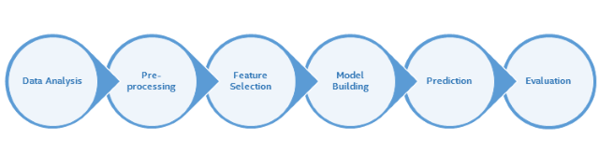
METHODOLOGY
The methodology, depicted in the following figure, has been adopted for conducting liver patient dataset classification experiment.

Slide 9
EXPLORATORY DATA ANYLYSIS
First we find out the correlation table from where we deduce that weakest correlation was observed between gender column with all other inputs as well as output, hence it is dropped.
The heatmap for the above is plotted fir visualization (graph 1)

Slide 10
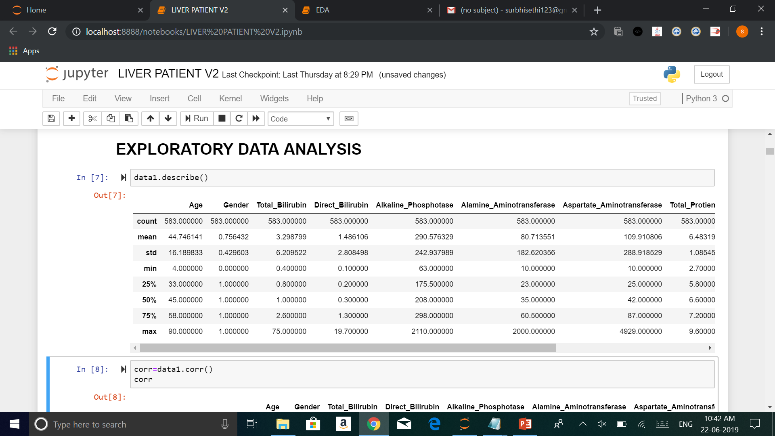
Describe function helps in descriptive analysis of each row whereby we find out various parameters like count ,minimum ,maximum ,standard deviation and values at each quartile

Slide 11
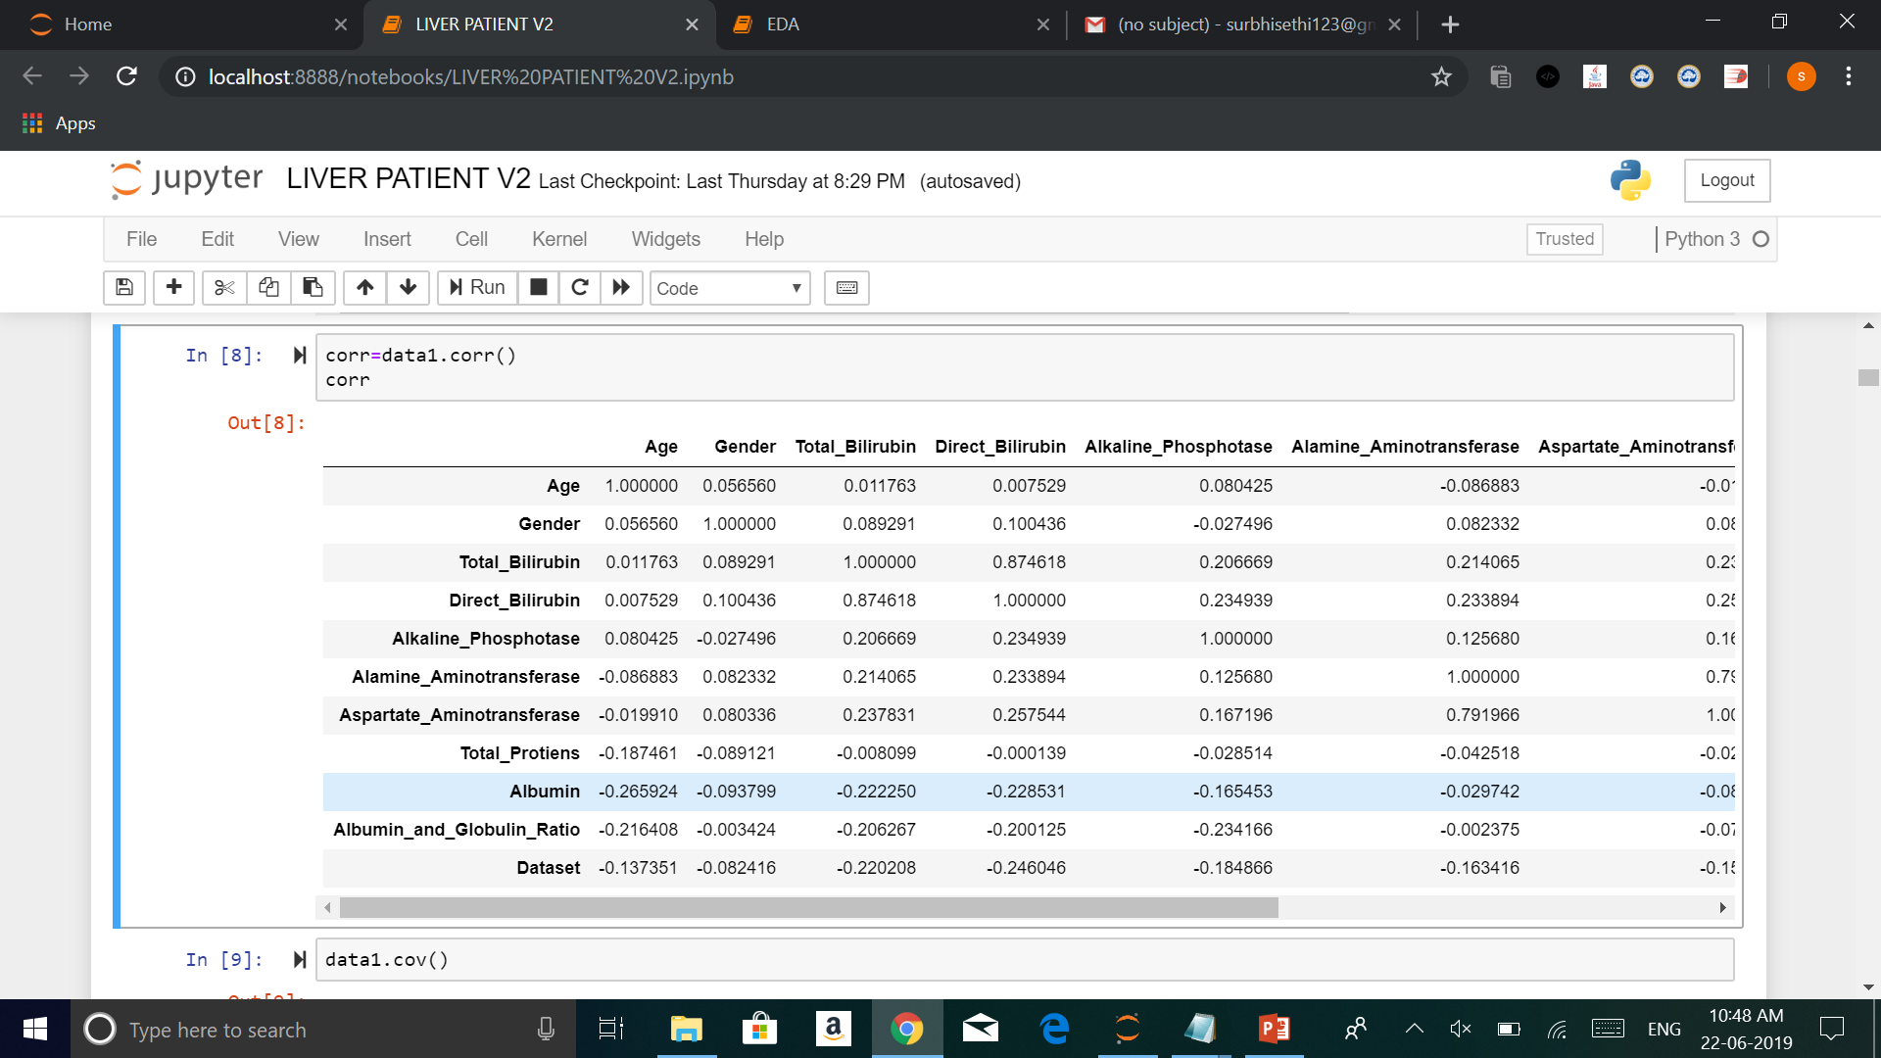
Correlation is a statistical technique that can show whether and how strongly pairs of variables are related. Correlation can be both positive and negative in the range of -1 to 1

Slide 12
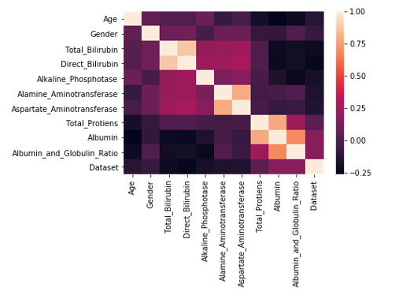
Heat map showing the correlation between different variables

Slide 13
The median age of the people having a liver ailment is 48 and 40 for people not having a liver ailment, hereby we observe no significant difference in ages .
Missing values were found out in the column Albumin_And_Globulin_Ratio which were imputed using mean strategy
We find the minimum age to be 4 years and maximum to be 90, any age above 90 is also taken in dataset as 90.
As data was not in similar ranges normalization was performed to bring the data in the scale of 0 to 1

Slide 14
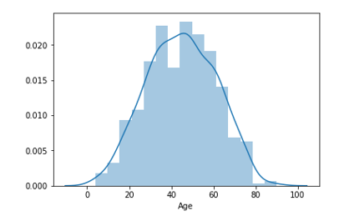
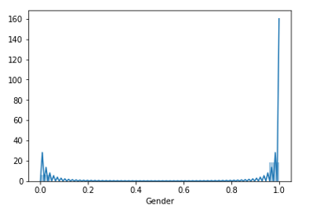
The distplot for different features is as follows

Slide 15
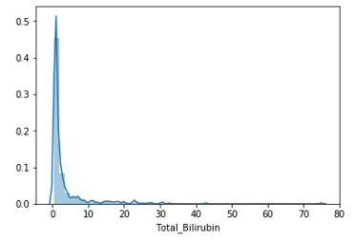
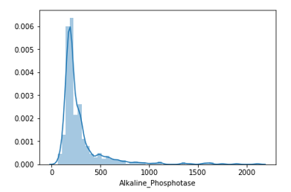

Slide 16
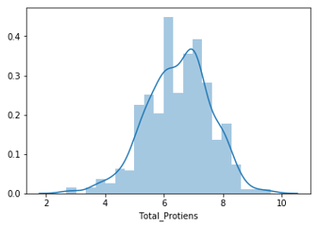
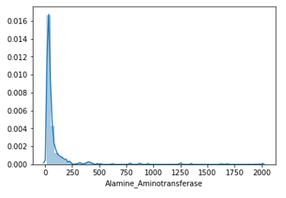
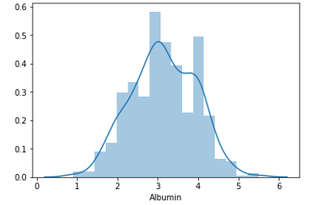

Slide 17
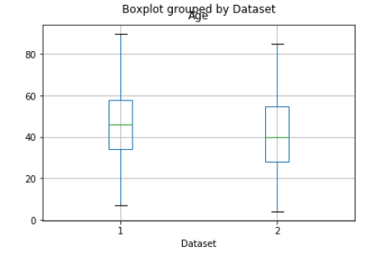

Slide 18
DATA MODELLING
The dataset is supervised single variate classification data thus in respect to it the following algorithms were used.
As the data is categorical algorithms like logistic regression ,support vector ,decision tree , random forest, naive bayes and KNN were used to obtain accuracy.
The data has been divided into test and training with 80-20 split which has given the maximum accuracy.
Logistic regression, random forest and support vector algorithm showed accuracy above 70%

Slide 19
CONFUSION MATRIX
Confusion matrix is a table that is often used to describe the performance of a classification model ,thus for our model -
TRUE POSITIVE (Doctor and model both predict unhealthy liver) | FALSE POSITIVE (Doctor predicts healthy liver but model gives the opposite prediction)
FALSE NEGATIVE (Doctor predicts unhealthy liver but model gives the opposite prediction) | TRUE NEGATIVE (Doctor and model both predict healthy liver)

Slide 20
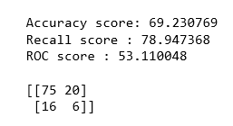
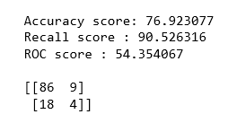
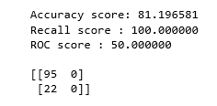
For Logistic regression following was observed
For Random forest algorithm following was observed
For Support vector classifier following was observed

Slide 21
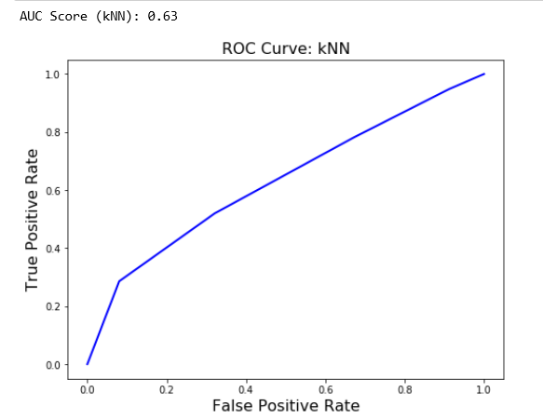
ROC AUC CURVES

Slide 22
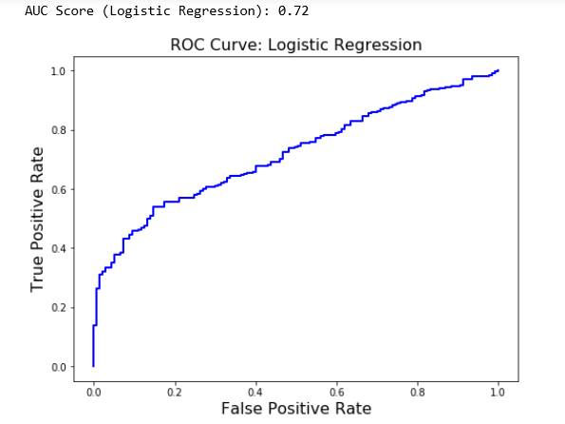
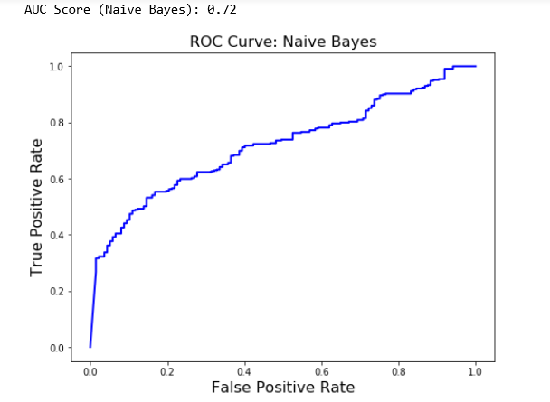

Slide 23
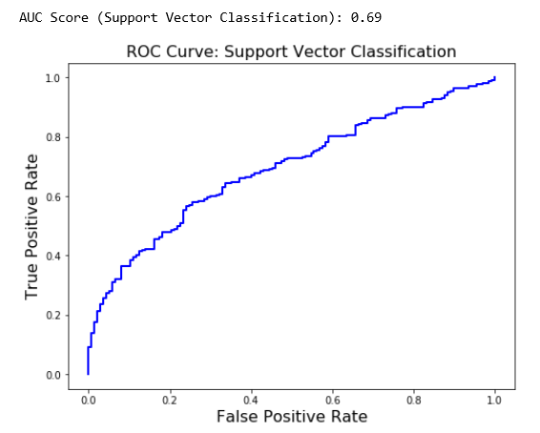
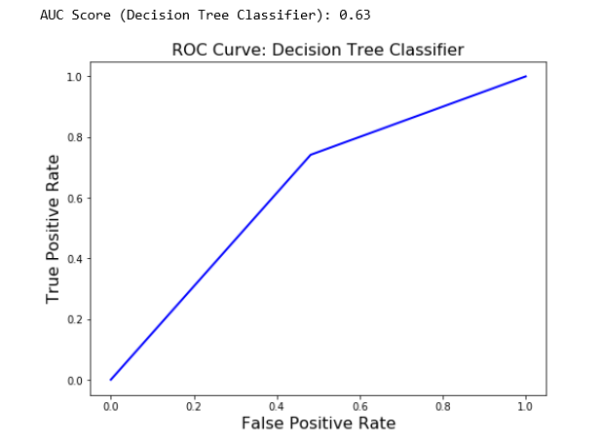

Slide 24
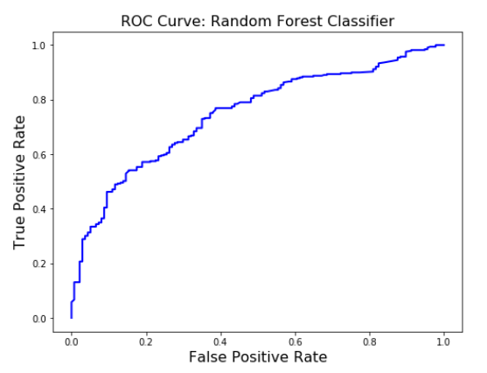

Slide 25
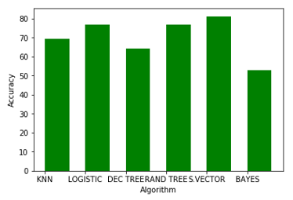
A bar graph was plotted showing final accuracies of different algorithms used so that the best model could be found and adopted which was observed to be support vector classification.

Slide 26
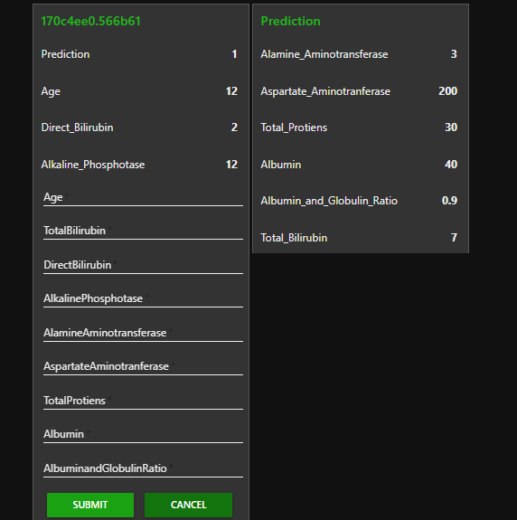
PREDICTION UI
The file is uploaded on Watson studios and then a user interface in created using node red to get prediction values

Slide 27
FINDINGS AND SUGGESTIONS
It is observed that Gender doesn’t play a major role and hence it can be dropped while doing the analysis. The correlation is very weak.
It is found that children aged below 10 have comparatively lesser unhealthy liver.
The main causes of this liver ailment can be excessive use of oil, egg which increases albumin.
The increased consumption of alcoholic drinks also play a major factor and that’s why more middle aged people from 30-60 suffer from liver problems.

Slide 28
CONCLUSION
This type of model might be useful in early detection, while not diagnosis because of the accuracy rate.
The model can be really helpful with racially more diverse training data set. We can also derive the further effect of Gender on the model.
Given the accuracy is 81% on the validation set, with further tuning of this model on more validation data, it might be useful as a tool to suggest further definitive testing of liver disease for patients who this model suggests might be positive.

Slide 29
BIBLIOGRAPY
www.kaggle.com
UCI Machine Learning Repository: ILPD (Indian Liver Patient Dataset) Data Set. (n.d.). Retrieved December 8, 2017, from https://archive.ics.uci.edu/ml/datasets/ILPD+(Indian+Liver+Patient+Dataset)
Liver Function Test Levels
https://www.emedicinehealth.com/liver_blood_tests/article_em.htm#what_are_the_symptoms_of_abnormal_levels_of_liver_enzymes

Slide 30
THANK YOU!

